Slide 1
The pace of the space race
Patricia King & William Watkins

Slide 2
Overview & objectives
Purpose
Organization
User
Sources

Slide 3
Purpose
To showcase the chronology of Atlas Rocket launches in the United States through our interactive GUI and visualization components.

Slide 4
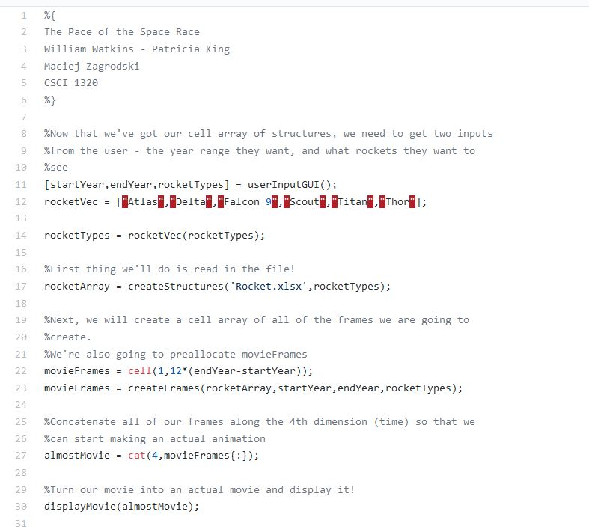
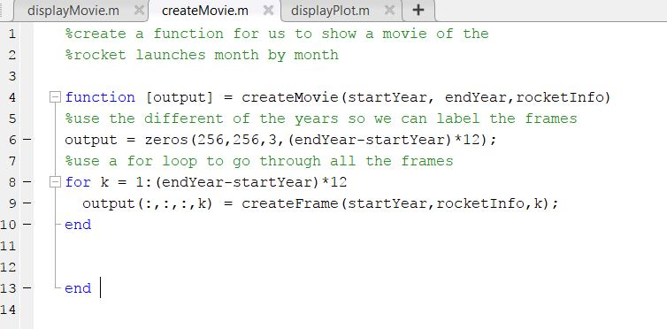
Organization
One main script with individual function calls
functions:
userInputGUI
getwebpageTable
displayPlot
displayMovie
createStructures
createMovie
createFrame
createRocketTypeStructures
gifPlayGUI

Slide 5

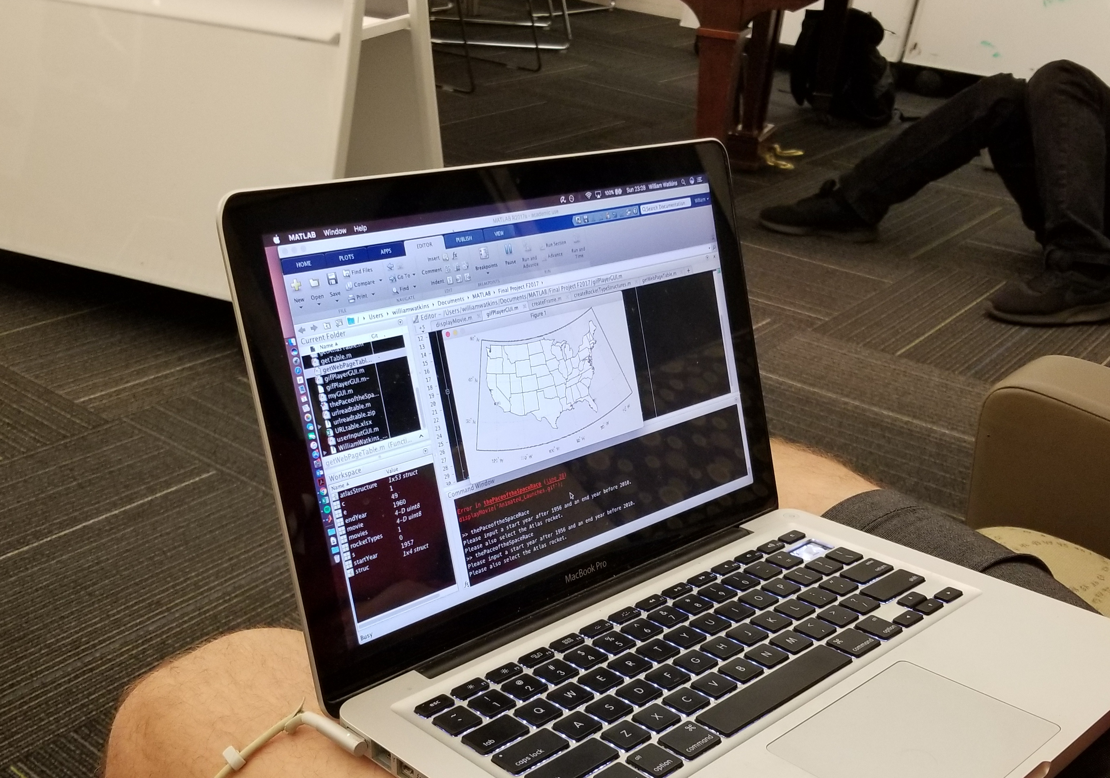
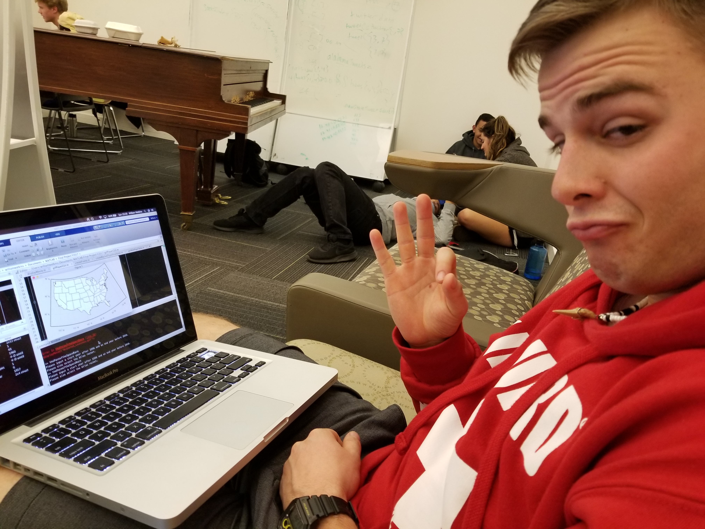
USer

Slide 6
Sources
Mathworks.com
William Watkins
Patricia King
https://stackoverflow.com/questions/19283464/plotting-points-on-a-map-in-matlab

